Slide 1
Module 2: Lesson 2:
Choose the best AI service for your needs.

Slide 2









About The Presenter
Sarmad Raza
Apps & Infra Lead at Information & Communication Technology Qatar
Microsoft Certified Cloud Specialist
4-year of hand on multi-cloud experience
Successful implementation of various national level projects including upcoming FIFA 2022
Passionate about AI, DevOps & Robotic Systems.
Notes:
How Cloud Can Help DevOps Transformation

Slide 3


Lesson 2: Overview
This lesson will cover
Azure Cognitive Services
Azure Bot Service
Azure Machine Learning Service
Notes:
How Cloud Can Help DevOps Transformation

Slide 4

Cognitive Services
Vision
From faces to feelings, allow your apps to understand images and video
Microsoft Cognitive Services
Give your apps a human side
Speech
Hear and speak to your users by filtering noise, identifying speakers, and understanding intent
Language
Process text and learn how to recognize what users want
Knowledge
Tap into rich knowledge amassed from the web, academia, or your own data
Search
Access billions of web pages, images, videos, and news with the power of Bing APIs

Slide 5

Categories of Cognitive Services
microsoft.com/cognitive
Vision
From faces to feelings, allow your apps to understand images and video
Vision
Speech
Language
Knowledge
Search
Computer Vision
Custom Recognition
Bing Spell Check
Academic Knowledge
Bing
Web Search
Emotion
Speaker Recognition
Linguistic Analysis
Entity Linking
Bing
Image Search
Face
Speech
Language Understanding
Knowledge Exploration
Bing
Video Search
Video
Translator
Text Analytics
Recommendations
Bing
News Search
WebLM
Bing
Autosuggest

Slide 6






Why Microsoft Cognitive Services ?
Vision
From faces to feelings, allow your apps to understand images and video
Easy
Flexible
Tested
Speech
Hear and speak to your users by filtering noise, identifying speakers, and understanding intent
Roll your own with REST APIs
Simple to use, just a few lines of code required
Make the same API code call on iOS, Android, and Windows
Integrate into the language and platform of your choice
Built by experts in their field from Microsoft Research, Bing, and Azure Machine Learning
Quality documentation, sample code, and community support
Language
Process text and learn how to recognize what users want
GET A KEY
BUILD
Knowledge
Tap into rich knowledge amassed from the web, academia, or your own data
Search
Access billions of web pages, images, videos, and news with the power of Bing APIs

Slide 7
Vision APIs
Computer Vision
The Computer Vision service provides you with access to advanced cognitive algorithms for processing images and returning information
Custom Vision Service lets you build, deploy, and improve your own image classifiers. An image classifier is an AI service that applies labels to images, based on their visual characteristics.
Custom Vision
Service
The Face service provides access to advanced face algorithms, enabling face attribute detection and recognition.
Face

Slide 8
Speech APIs
Speech-to-text
The Computer Vision service provides you with access to advanced cognitive algorithms for processing images and returning information
Custom Vision Service lets you build, deploy, and improve your own image classifiers. An image classifier is an AI service that applies labels to images, based on their visual characteristics.
Text-to-speech
Speech translation & more
The Face service provides access to advanced face algorithms, enabling face attribute detection and recognition.

Slide 9
Decision APIs
Anomaly Detector
The Computer Vision service provides you with access to advanced cognitive algorithms for processing images and returning information
Custom Vision Service lets you build, deploy, and improve your own image classifiers. An image classifier is an AI service that applies labels to images, based on their visual characteristics.
Content Moderator
The Face service provides access to advanced face algorithms, enabling face attribute detection and recognition.
Personalizer

Slide 10
Search APIs
Bing News Search
Bing Video Search
Bing Web Search
Bing Autosuggest
Bing Custom Search
Bing Image Search
Bing Spell Check
Bing Local Business Search
Bing Entity Search

Slide 11
Demo

Slide 12

Azure Bot Service
Azure Bot Service is Microsoft's artificial intelligence (AI) chatbot offered as a service on the Azure cloud service marketplace. Azure Bot Service offers the ability to add intelligent agents that are capable of conversation without having to commit the resources to develop one's own AI.

Slide 13
Development Options
Bot Framework Composer
An open-source IDE built on the bot Framework SDK. Composer lets you build chatbots with a visual authoring canvas, and extends with code.
Bot Framework SDK
A modular set of developer tools to build, test, deploy , and manage chatbots in C#, Java, JavaScript or python
Power Virtual Agents
Create chatbots with an easy to use graphical interface. No coding or AI expertise required. Works with Power Apps, and extendable with code.

Slide 14
Features
Adaptive Dialogs
Language Understanding
Language Generation
QNA Maker
Bot Framework Emulator

Slide 15
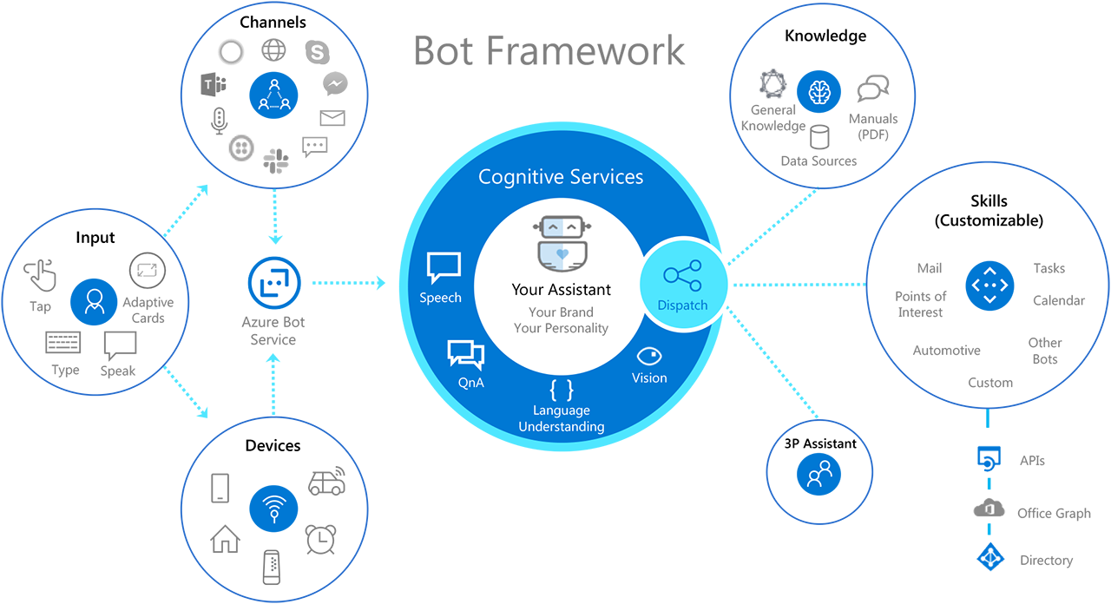
Bot Framework

Slide 16
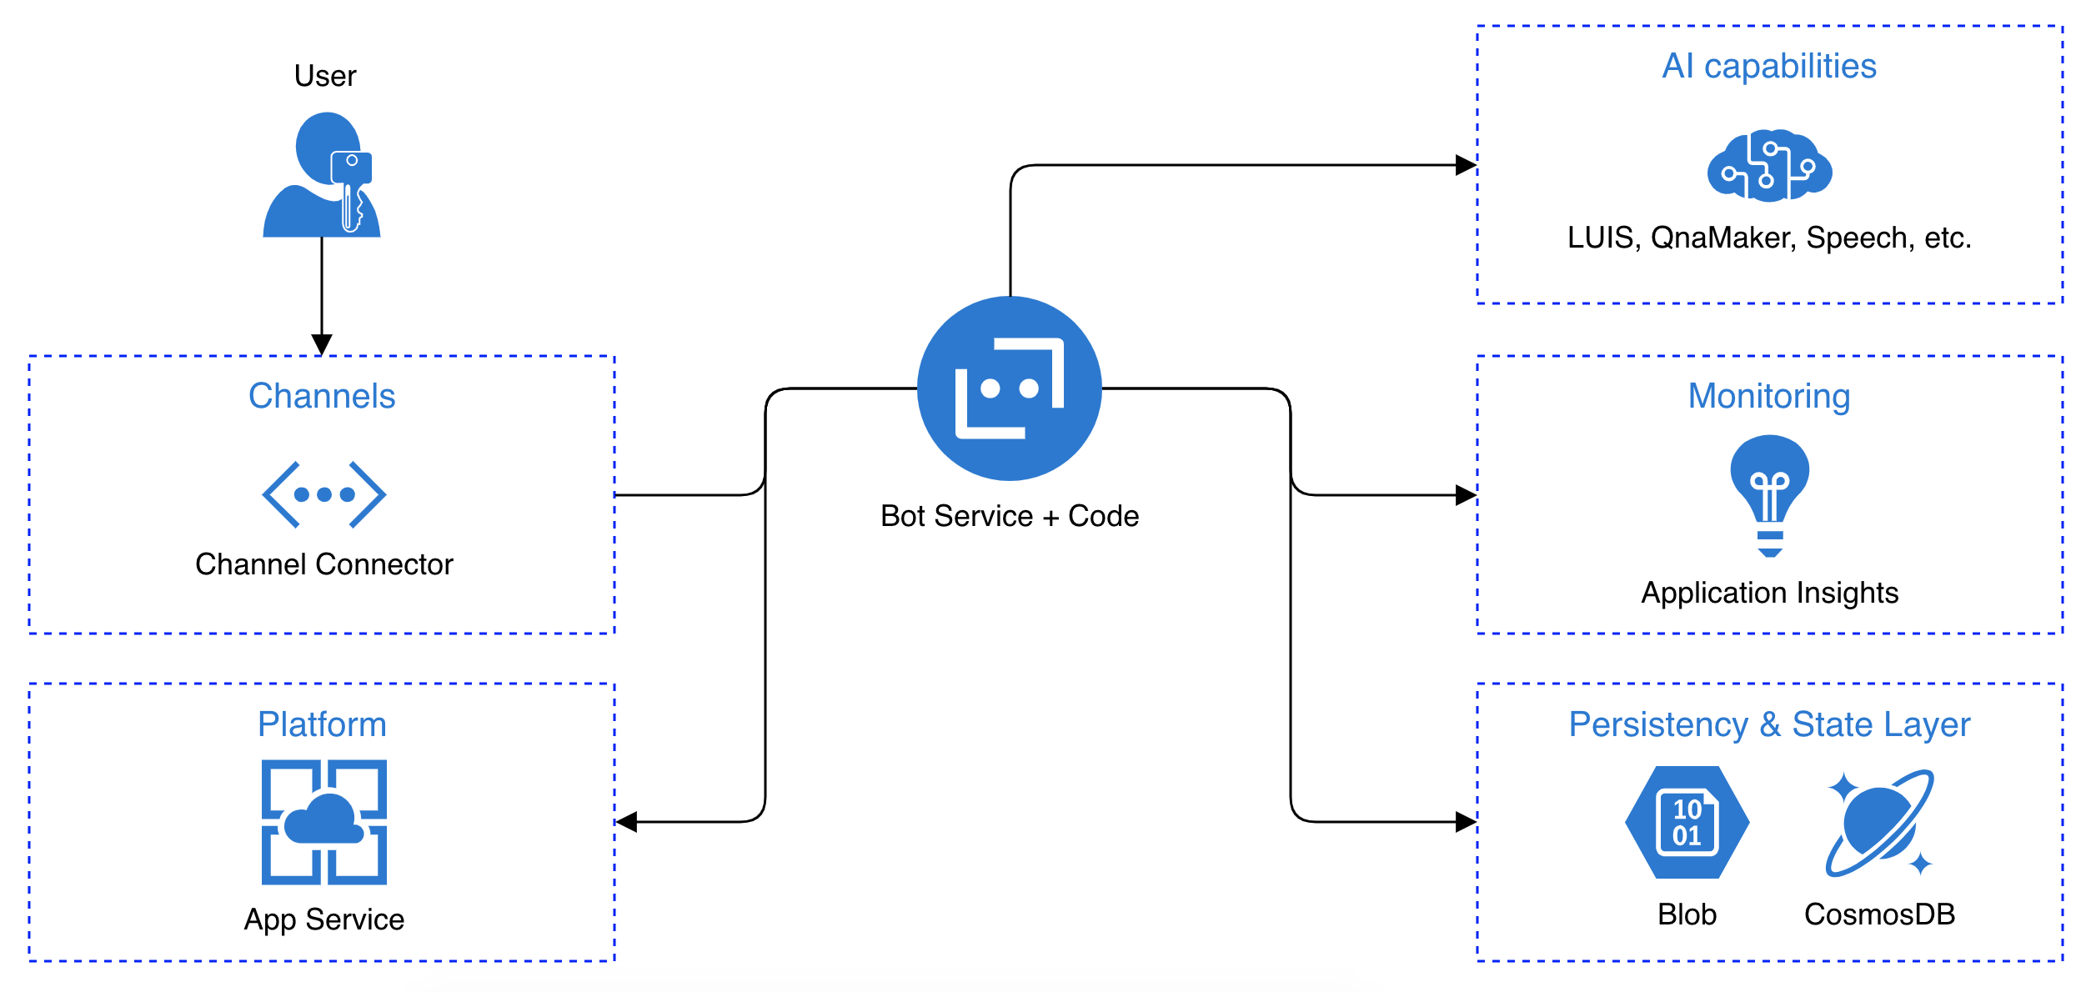
Bot Architecture on Azure

Slide 17
Demo

Slide 18

Azure Machine Learning
Microsoft Azure Machine Learning is a collection of services and tools intended to help developers train and deploy machine learning models

Slide 19
Key Features
Datastores
Compute
Notebooks
Automated ML

Slide 20
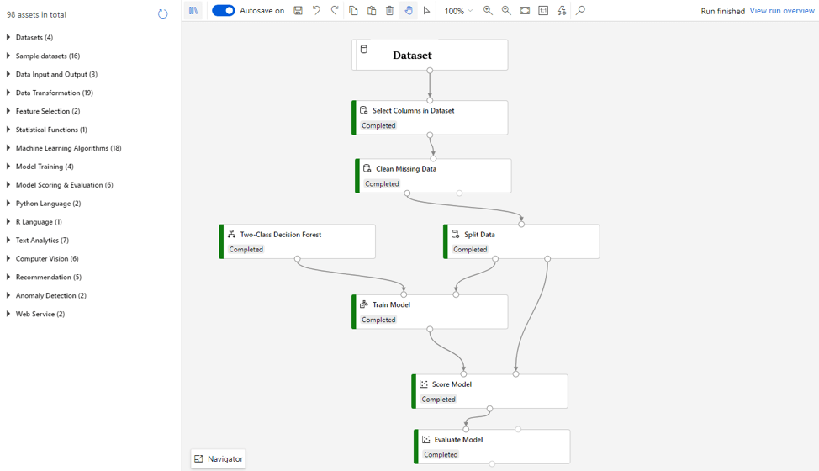
Key Features Designer GUI

Slide 21
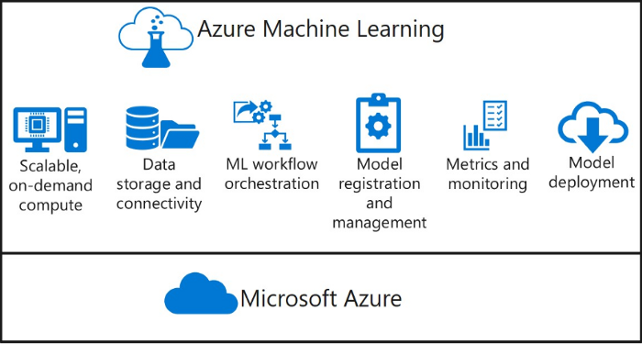
Capabilities

Slide 22
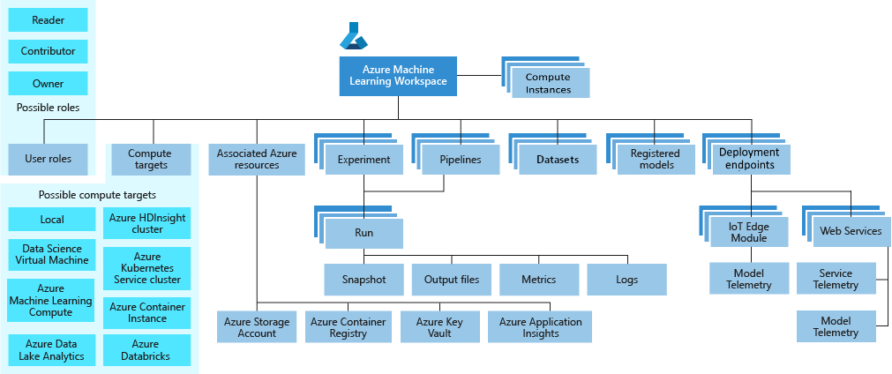
Workspace for Azure ML resources

Slide 23
Azure Machine Learning Pipelines
Prepare data
Build & train models
Deploy & predict
Data Preparation
Model building & training
Model deployment
Data ingestion
Normalization
Hyper-parameter tuning
Deployment
Transformation
Automatic model selection
Batch scoring
Validation
Model testing
Data storage locations
Featurization
Model validation

Slide 24
Advantages of Azure ML Pipelines
Unattended runs
Schedule a few steps to run in parallel or in sequence to focus on other tasks while your pipeline runs
Tracking and versioning
Name and version your data sources, inputs and outputs with the pipelines SDK
Reusability
Create templates of pipelines for specific scenarios such as retraining and batch scoring
Mixed and diverse compute
Use multiple pipelines that are reliably coordinated across heterogeneous and scalable computes and storages

Slide 25








Popular Frameworks
Use your favorite machine learning frameworks
without getting locked into one framework
TensorFlow
PyTorch
Scikit-Learn
ONNX
Community project created by Facebook and Microsoft
Use the best tool for the job. Train in one framework and transfer to another for inference
MXNet
Chainer
Keras

Slide 26
Azure Machine Learning service
Bring AI to everyone with an end-to-end, scalable, trusted platform
Built with your needs in mind
Boost your data science productivity
Automated machine learning
Managed compute
Increase your rate of experimentation
Simple deployment
DevOps for machine learning
Support for open source frameworks
Deploy and manage your models everywhere
Tool agnostic Python SDK
Seamlessly integrated with the Azure Portfolio

Slide 27
Demo

Slide 28

Summary
This lesson has covered
Azure Cognitive Services
Azure Bot Service
Azure Machine Learning Service

